Slide 1

Memory and Disk Forensics in WhatsApp Web: Analyzing RAM, Hard Drive, and Snapshot Integrity
-Alfredo Madrigal

Slide 2
APPROACH
A VMware Workstation Pro was utilized to create three virtual machines: VM1, VM2, and a forensic workstation (FW). VM1 and VM2 were designated for WhatsApp experiments, and FW was used for RAM analysis. The physical workstation used for hosting the virtual machines was an Acer Nitro 5 with the following specifications: Intel Core i5-12500H, 16GB RAM, 512GB SSD, and NVIDIA GeForce RTX 3050 Ti.
Google voice was used to create the phone number for User1 and User2.
Autopsy 4.21.0 was selected as the primary forensic tool due to its robust capabilities for RAM and disk image analysis.
To ensure data integrity, the MEmu Android emulator provided isolated Android environments, allowing each user account (User 1: (762)-499-6051 and User 2: (470)-208-1240) to interact with WhatsApp Web without cross-contaminating data.

Slide 3
Tools and ways to extract data
RAM.- The tool Magnet was used to extract the information from the Virtual Machines RAM.
Hard Drive.- Look for the .vmdk file where the VM is install in the host computer.
Snapshoots.- VMware lets you get a .vmsn file from the Virtual Machine after that is need to be merge with a .vmdk so that Autopsy can recognized the file.
vmware-vdiskmanager -r base.vmdk -t 0 new-disk.vmdk
Replace base.vmdk with your base disk file name and path.
The -t 0 option tells VMware to create a single, consolidated .vmdk file.
The resulting new-disk.vmdk will be the merged disk, which combines the base disk and snapshot changes.

Slide 4
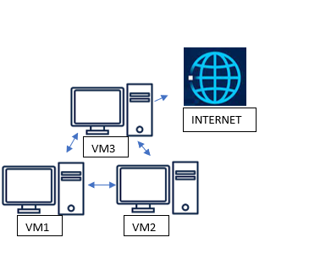
Virtual machines diagram

Slide 5
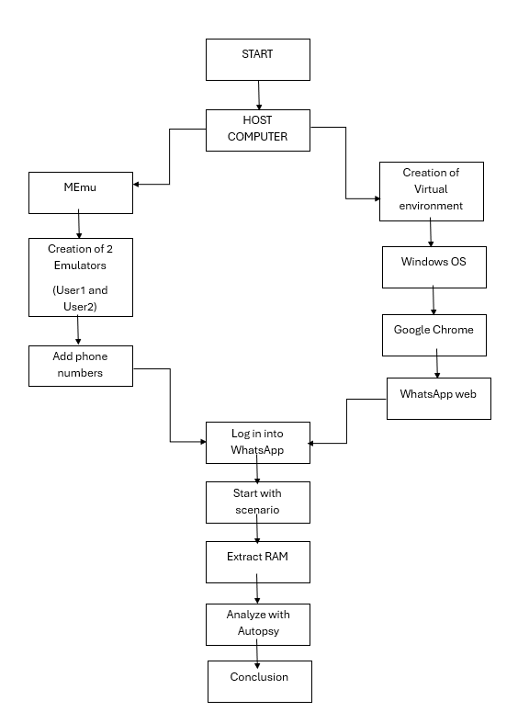

Slide 6
Scenario
Before the investigation, two separate accounts were created on the WhatsApp web platform to construct a simulated scenario aimed at mimicking real-world conditions. The primary goal of this simulation was to capture the Random Access Memory (RAM) within each corresponding virtual machine using the Magnet tool.
The simulated scenario encompassed a range of activities mirroring typical user interactions on WhatsApp Web. These activities included generating updates, conducting polls, engaging in text-based communication, and sending images.
Additionally, a comprehensive assessment was undertaken to identify any potential exposure of sensitive information, such as genuine names, email addresses, and phone numbers. It is crucial to emphasize that this analysis took place on two distinct virtual machines, each identified as User1 and User2.

Slide 7
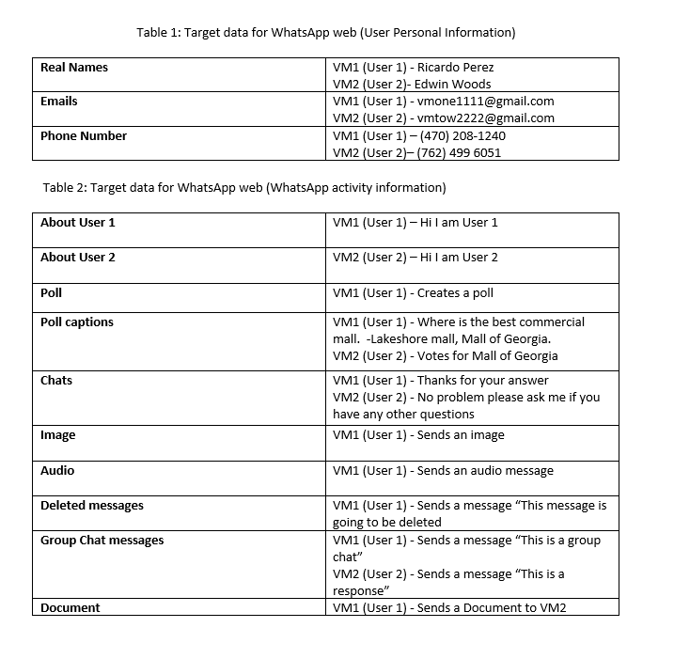

Slide 8
File types.
Unallocated file.- An "unallocated file" refers to a file that no longer has an entry in the file system's directory structure but still exists in the storage media. Therefore, many of the text, Images and other information used in WhatsApp web may be found in an Unallocated area after WhatsApp web has been closed.
.MIME .- Is a generic type of file that indicates that the associated file is binary data and does not fit into any other specific category. It is often used when the server or sender does not know the exact type of file being transmitted, or when the file format is not recognized by the recipient.
.EXE and .MFT .- is important to understand that these types of file format might appear in this type of forensic analysis because Autopsy might have misrepresented the file. Another option would be that because .exe and .mft file format also saves information briefly it might have shown that way in this case.

Slide 9
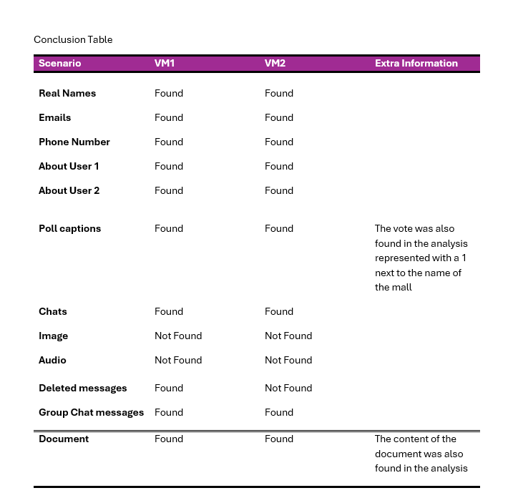
RAM analysis conclusion table

Slide 10
RAM analysis conclusion
Following the comprehensive analysis conducted on both virtual machines, it can be affirmed that a significant portion of the data has been effectively obtained, with most of the targeted information successfully recovered through RAM analysis. Also, is clear that the Unallocated file predominates on the finds of target data thanks to the nature of WhatsApp web but is clear that other files are present on some occasions like .dlls, .exe and .mft this is most likely to happened due to Autopsy misrepresenting the file.

Slide 11
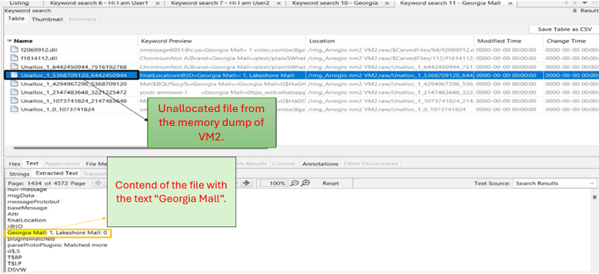
Screenshot of the analysis in Autopsy.

Slide 12
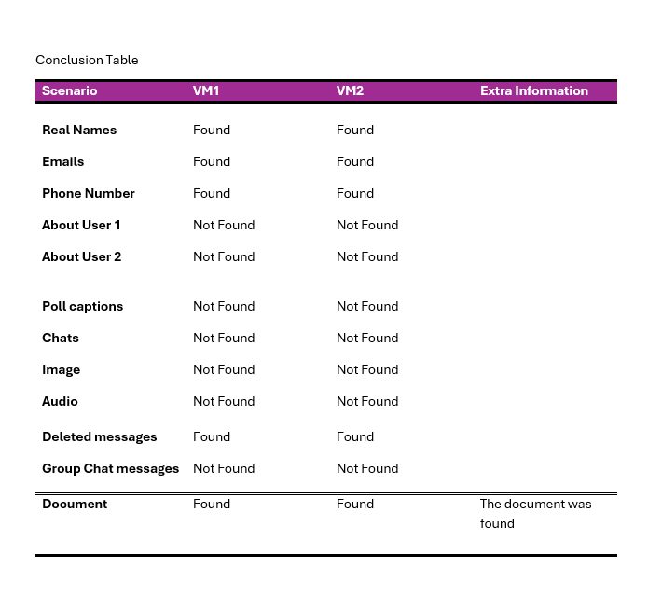
Conclusion table for Hard drive.

Slide 13
Hard Drive analysis conclusion
After the analysis I was surprised by the fact that the there was less information found in a hard drive then in RAM. Another thing to point out is that with the analysis of the Hard Drive the files that were seen the most were the JSON files and not the unallocated ones like in the RAM. Also, a .MFT file showed up, but this time it made senset to be there.

Slide 14
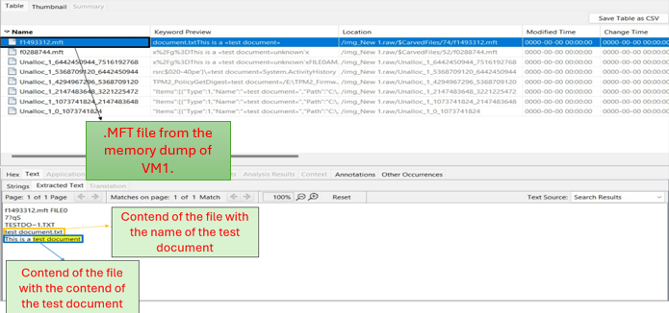
Screenshot of the analysis in Autopsy.

Slide 15
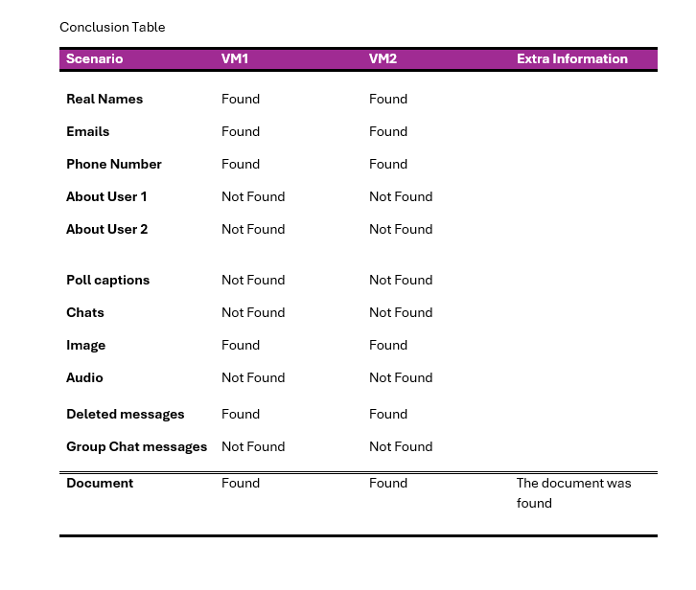
Snapshoot analysis conclusion table

Slide 16
Snapshoots analysis conclusion
Looks like the results were like the hard drive ones including the file types and the findings of the target data.

Slide 17
Work cited.
Forensics Wiki. (n.d.). Virtual Disk Images. Retrieved from http://forensicswiki.org/wiki/Virtual_disk_images

